Slide 1

Technology Operations
Input Devices
Session 1
Tutor: Tshewang Dhendup

Slide 2
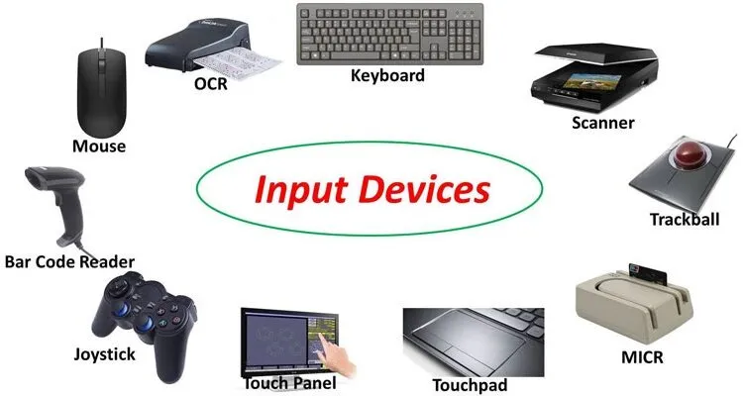

Input Devices
Learning Objectives:
At the end of the lesson, you should be able to:
define the term input device in your own words.
name at least three input devices.
explain the importance of different input devices.

Slide 3
Input Devices
What is an input devices?
The devices that are used to enter data and instructions or commands into the computer.
Eyes and ears of computer.
Commonly used input devices are :
Keyboard
Mouse
Joystick
Bar Code Reader
Scanner

Slide 4
Input Devices
Keyboard
A keyboard is an input device used to enter characters and commands into a computer or other electronic device..
Contain keys for each alphabetic characters, digits and special characters.
The most common keyboard layout is the QWERTY layout, which are the standard layout used in most English-speaking countries, and ergonomic keyboards, which are designed to reduce stress and strain on the hands and wrists during extended typing sessions.
Notes:
It typically contains a set of keys arranged in a specific layout, with each key corresponding to a specific letter, number, symbol, or function.

Slide 5
Input Devices
Functions of keyboard:
The main function of a keyboard is to allow users to enter text, numbers, and other characters into a computer or other device.
It can also be used to control the device or perform specific functions, such as adjusting volume or changing screen brightness.

Slide 6
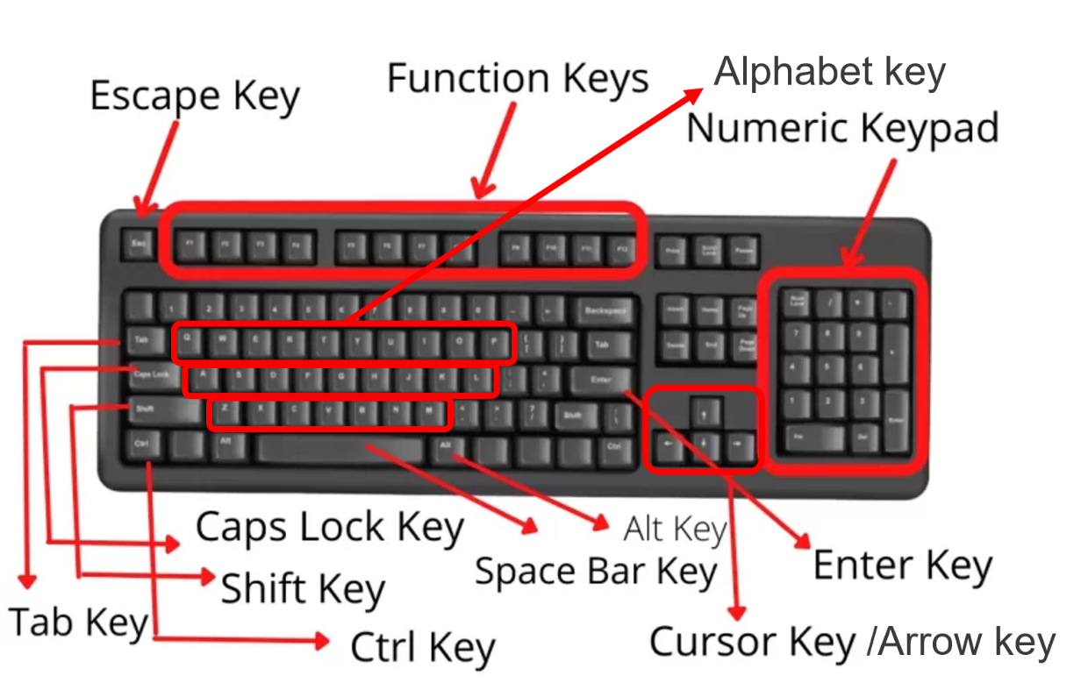
Input Devices
Sections or Parts of Keyboard :
The keys on a keyboard are typically arranged in sections of keys.
The section are:
Alphabet keys section,
Function keys section,
Arrow keys section,
Numeric keypad section.
Follow the link to check your understanding:
https://www.liveworksheets.com/ja1658954ne

Slide 7
Input Devices
Pointing Devices:
Pointing devices are input devices used to control the movement of a cursor or pointer on a computer screen.
Allow the user to interact with the graphical user interface (GUI) of a computer.
Some example of pointing devices are:
Mouse
Joystick
Touchpad
Microphone
Notes:
what is pointing devices?
Pointing devices are input devices used to control the movement of a cursor or pointer on a computer screen. These devices allow users to navigate through graphical user interfaces and interact with software applications.
There are several types of pointing devices, including:
Mouse: A mouse is a hand-held device that is moved across a flat surface to control the movement of the cursor on the computer screen.
Trackball: A trackball is a pointing device that consists of a ball that can be rotated to control the movement of the cursor on the screen.
Touchpad: A touchpad is a flat surface on a laptop computer that can be touched with a finger to control the movement of the cursor.
Joystick: A joystick is a hand-held device that is typically used for gaming and can be used to control the movement of a cursor or object on the screen.
Stylus: A stylus is a pen-like device that is used to draw or write on a touch screen or graphics tablet.
Pointing devices are an essential part of computer interaction and are used in a wide range of applications, from gaming to design to everyday computer use.

Slide 8
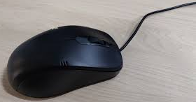
Input Devices
Pointing Devices:
1. Mouse:
A mouse is a pointing input device that is used to move a cursor on a computer screen.
Moved on the flat surface to control the movement of the cursor or pointer on the screen
Has two or there buttons
on the top of its body
Notes:
Used to input instruction with a pointer on the screen

Slide 9
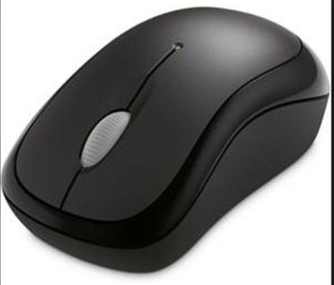
Input Devices
Function of Mouse:
Used to select any option from the group of options by pointing the mouse pointer on it and then clicking one of the mouse buttons.
Notes:
Used to input instruction with a pointer on the screen

Slide 10
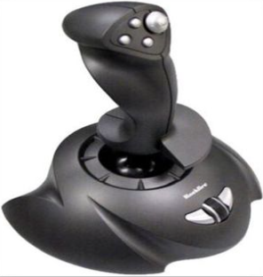
Input Devices
Pointing Devices:
2. Joystick:
A joystick is a input device that allows you to control the movement of a cursor or object on the screen.
Small box with a moving handheld stick and buttons.

Slide 11
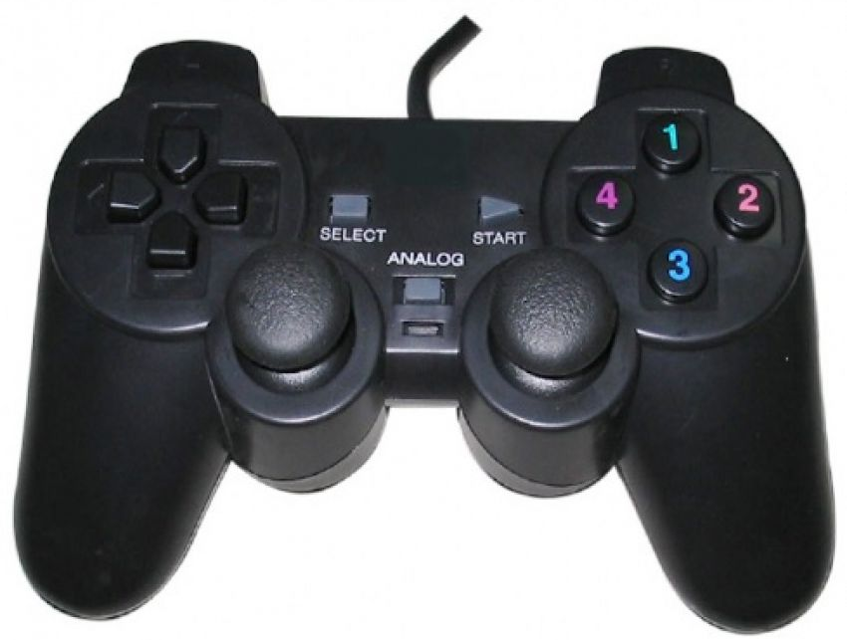
Input Devices
Functions of Joystick:
Joysticks are commonly used in video games, flight simulators, and other applications where precise, intuitive control is important

Slide 12
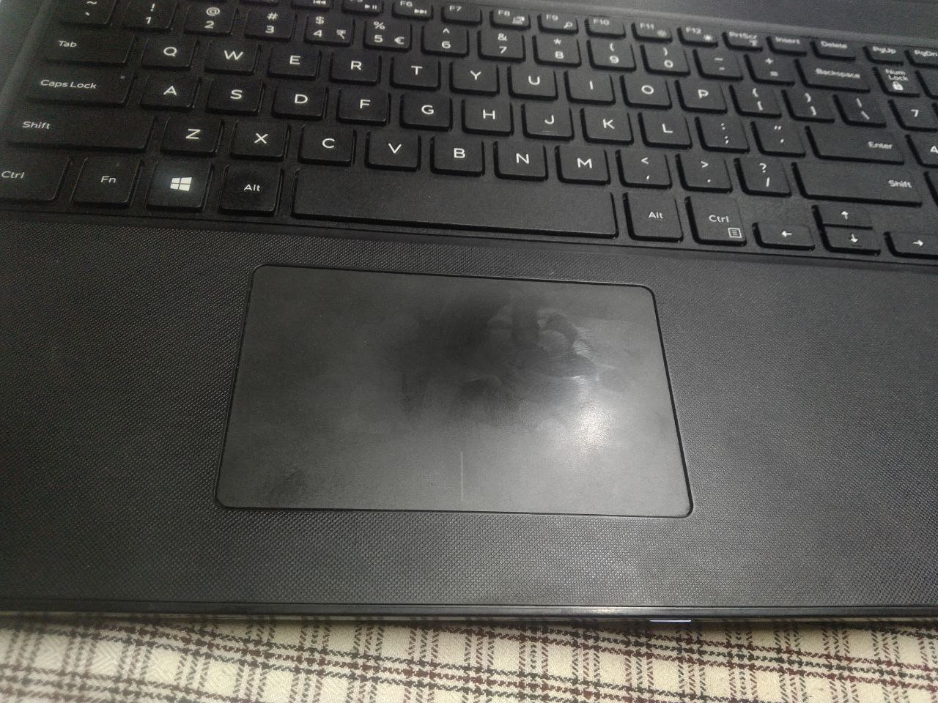
Input Devices
Pointing Devices:
3. Touchpad:
A touchpad is a flat surface on a laptop computer that can be touched with a finger to control the movement of the cursor.
It works by detecting the movement of a user's finger or fingers as they glide over its surface.

Slide 13
Input Devices
Functions of Touchpad:
The primary function of a touchpad is to replace the traditional mouse that would otherwise be connected to a desktop computer.
This makes it easier to navigate the computer screen and perform tasks, such as selecting items, scrolling through documents or web pages, and dragging and dropping files.
Notes:
In addition to basic cursor movement, touchpads can also support additional features such as multi-finger gestures, which allow users to zoom in and out, rotate images, and perform other functions by using specific combinations of finger movements.
Overall, the touchpad is an important input device that provides a convenient and efficient way for users to interact with their computers without the need for an external mouse or other input device.

Slide 14
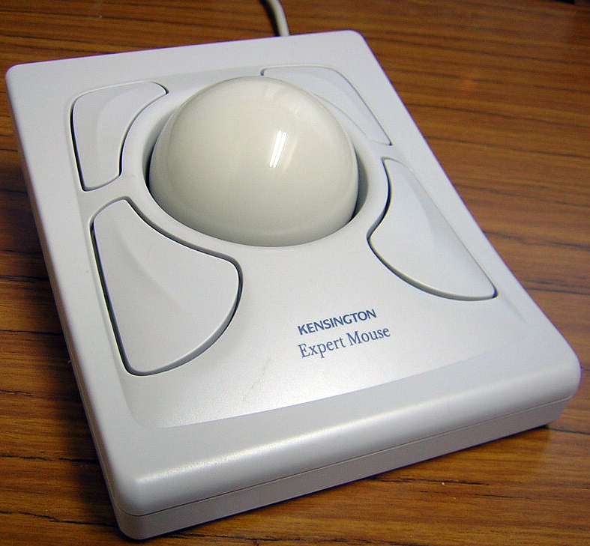
Input Devices
Pointing Devices:
4. Trackball:
Pointing input devices like a mouse but a stationary pointing device with a ball on its top.
The user rotates the ball with their
fingers, palm, or thumb to move the
cursor on the screen.

Slide 15
Input Devices
Function of Trackball:
Trackballs are used as an alternative to a traditional mouse, particularly in situations where space is limited or precise control is required.
They are commonly used in applications such as CAD/CAM, graphics design, and gaming.
Trackballs can also be found in some laptops and other portable devices as a built-in pointing device.
Notes:
CAD/CAM stands for Computer-Aided Design and Computer-Aided Manufacturing. It is a technology that uses computer software to aid in the design and manufacturing of products.
CAD refers to the use of computer software to create detailed 2D or 3D models of a product or component. These models can be easily modified and tested virtually, which allows for faster design iterations and reduced design costs.
CAM, on the other hand, refers to the use of computer software to create instructions for the manufacturing process. CAM software takes the digital design created in CAD and creates toolpaths that guide automated machines in the production of the product.
Together, CAD/CAM technology allows for the complete digitalization of the product design and manufacturing process, from initial concept to final production. This technology has revolutionized the manufacturing industry, making it possible to design and produce complex products with high precision and accuracy.

Slide 16
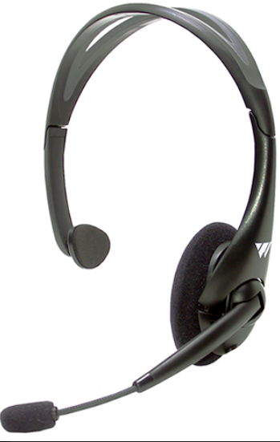
Input Devices
5. Microphone:
A microphone is an input device that allows
users to record audio or input voice commands.
Record the voice of the user in computer

Slide 17
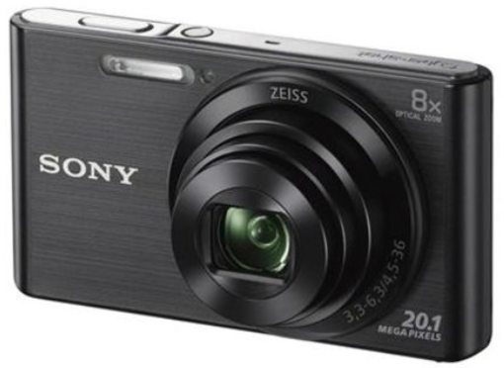
Input Devices
6. Digital Camera:
Input device used to take pictures and to
store directly into the computer in digital form.

Slide 18
Home Work
Do It Yourself:
Complete a 10-question quiz on the input devices using the link https://reviewgamezone.com/mc/candidate/test/?test_id=10333. Click on the button at the end to check the result and get the answers. Redo the quiz until you get the full score.
Follow the link to watch the video, https://www.youtube.com/watch?v=wUHGN-B1tt0 to get further information on input devices. List down the additional input device(s) mentioned in the video in your notebook.

Slide 19
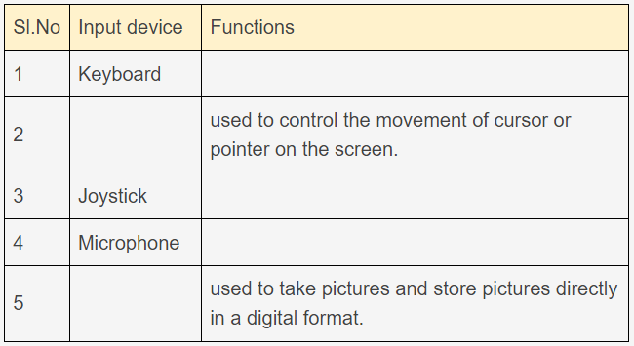
Home Work
Do It Yourself:
Go through the slides on the input device given in the link (https://slideplayer.com/slide/11866216/) and complete the table given below by filling the empty cells..

Slide 20


